Slide 1

Lungs Cancer Detection Using Machine Learning Algorithm
For Shark Tank 2.0
By . . .
Sandesh Gajendra Pol
Sushant Bharat Khadake

Slide 2
Point to be discussed
01 Economic And Statistical Analysis
02 Working of Project
03 Business Model
04 Market Analysis
05 Related application for Future

Slide 3
Need For World
General System Analysis
Our Trained Modul :
Higher rate of Early detection 94.07%.
More affordable Method Over traditional methods.
Budget – Friendly.
Statistical Value:
ML models can achieve high accuracy in cancer detection.
Maintenance and Updates: Regular model updates, bug fixes, and security patches are essential.
Burden on World:
In 2023 the approximately 2 million people get affected by cancer
And about 6.6 lakhs (0.66 million) people get Died
Detection of Lungs Cancer:
Problem In Early Detection
10.6% rate of cancer
Screening:
It have the effectiveness of screening method like LDCT , chest X-ray , PTE Scan etc.
But the its very expensive 2000.Rs up-to 50000.Rs .
Assets:
General System need More Assets such as Medical Equipment , Hospital facility , Well trained human resource , Financial Resource.
C
Economic And Statistical Analysis
B
A

Slide 4







Working of Project
Match the image pattern with .h5 module treaded module
Load the saved module (.h5)
Give result of prediction in graph form
Get new chest X-ray
( .png format )
Generate report with standard value
Process the image

Slide 5

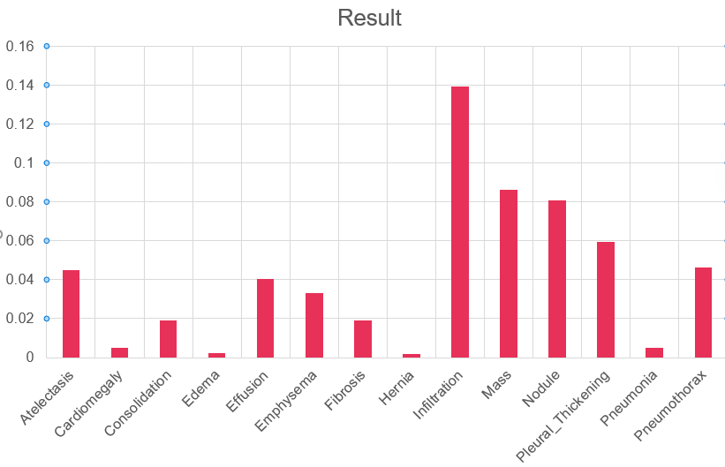

Business Model
1. Value Proposition:
Our project is an accurate and efficient lung cancer detection system for early diagnosis
We provide a non-invasive, cost-effective, and timely solution for both patients and healthcare providers.
2. Target Audience:
Healthcare institutions (hospitals, clinics, diagnostic centers).
Research institutions and universities.
Pharmaceutical companies for clinical trials.
Individuals at high risk or with a family history of lung cancer.

Slide 6

Business Model
3.Revenue Streams:
•Licensing fees for healthcare institutions to use the detection system.
•Subscription models for continuous updates and support.
•Collaborations with pharmaceutical companies for research partnerships.
•Direct-to-consumer thought health care event.
4. Cost Structure:
• Research and development costs.
Regulatory compliance expenses.
Marketing and promotional expenses.
Operational costs for ongoing maintenance and support.

Slide 7
Market Analysis
1
2
3. Target Market Segmentation
Institutions (60%),
research institutions and universities (20%),
pharmaceutical companies for clinical trials (10%),
individuals at high risk (10%).
4. Economic Viability:
Favorable cost-benefit analysis:
Cost of our system vs. potential healthcare savings from early detection and streamlined treatment.
Market Overview
Valued at USD 2.61 billion in 2020, it is projected to reach USD 4.85 billion by 2028 (CAGR of 8.1%).
2. Key factors driving growth:
Increasing incidence of lung cancer due to rising smoking population.
Technological advancements in screening techniques.
No Government support for early detection.
Slide references : fortunebusinessinsights.com2 coherentmarketinsights. businessresearchinsights.com

Slide 8

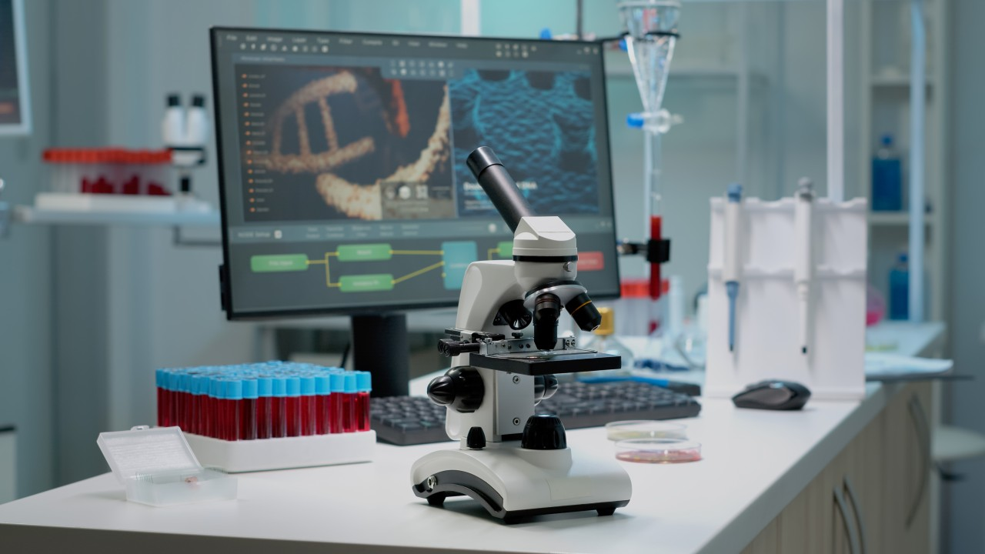


Related Application for business model
Block chain for Secure and Efficient Health Data Sharing
Personalized Cancer Treatment Plans using Genomic Data
Cancer Support Chabot for Patients and Caregivers
Smart Wearable's for Monitoring Cancer Patients

Slide 9

Conclusion
Current condition of lungs cancer treatment in India
This idea will make revolutionary in medical diagnosis because of AI and ML
This is very affordable and time saving idea of early lungs cancer detection and diagnosis

Slide 10

THANK YOU!
Sandesh Pol
Sushant Khadake
Phone:
9067248106|9881974088
Email:
sandeshpol268@gmail.com
sushantkhadake16@gmail.com

